Slide 1
Final Presentation
INFO5001: Application Modeling & Design SEC 01 Fall 2021
Name:Jiao He
NUID: 002192150

Slide 2
BACKGROUND
Based on Apple Products
Different customers in different markets will pay different for the same product.
User of this Application
This model is designed for two charactors: Manager and Customer.
Core class description:Markets,Channel,Ads,Bundles,Products
There are two Markets and three Channels under each of them.
There are two Ads, some bundles and products under each channel.
Creative idea
Email verification.

Slide 3
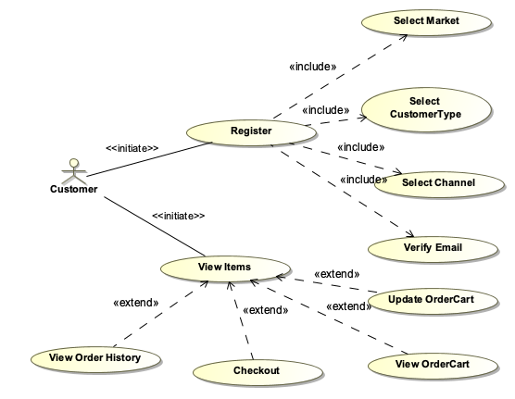
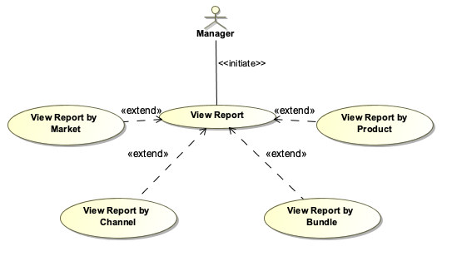
UML（use case diagram）

Slide 4
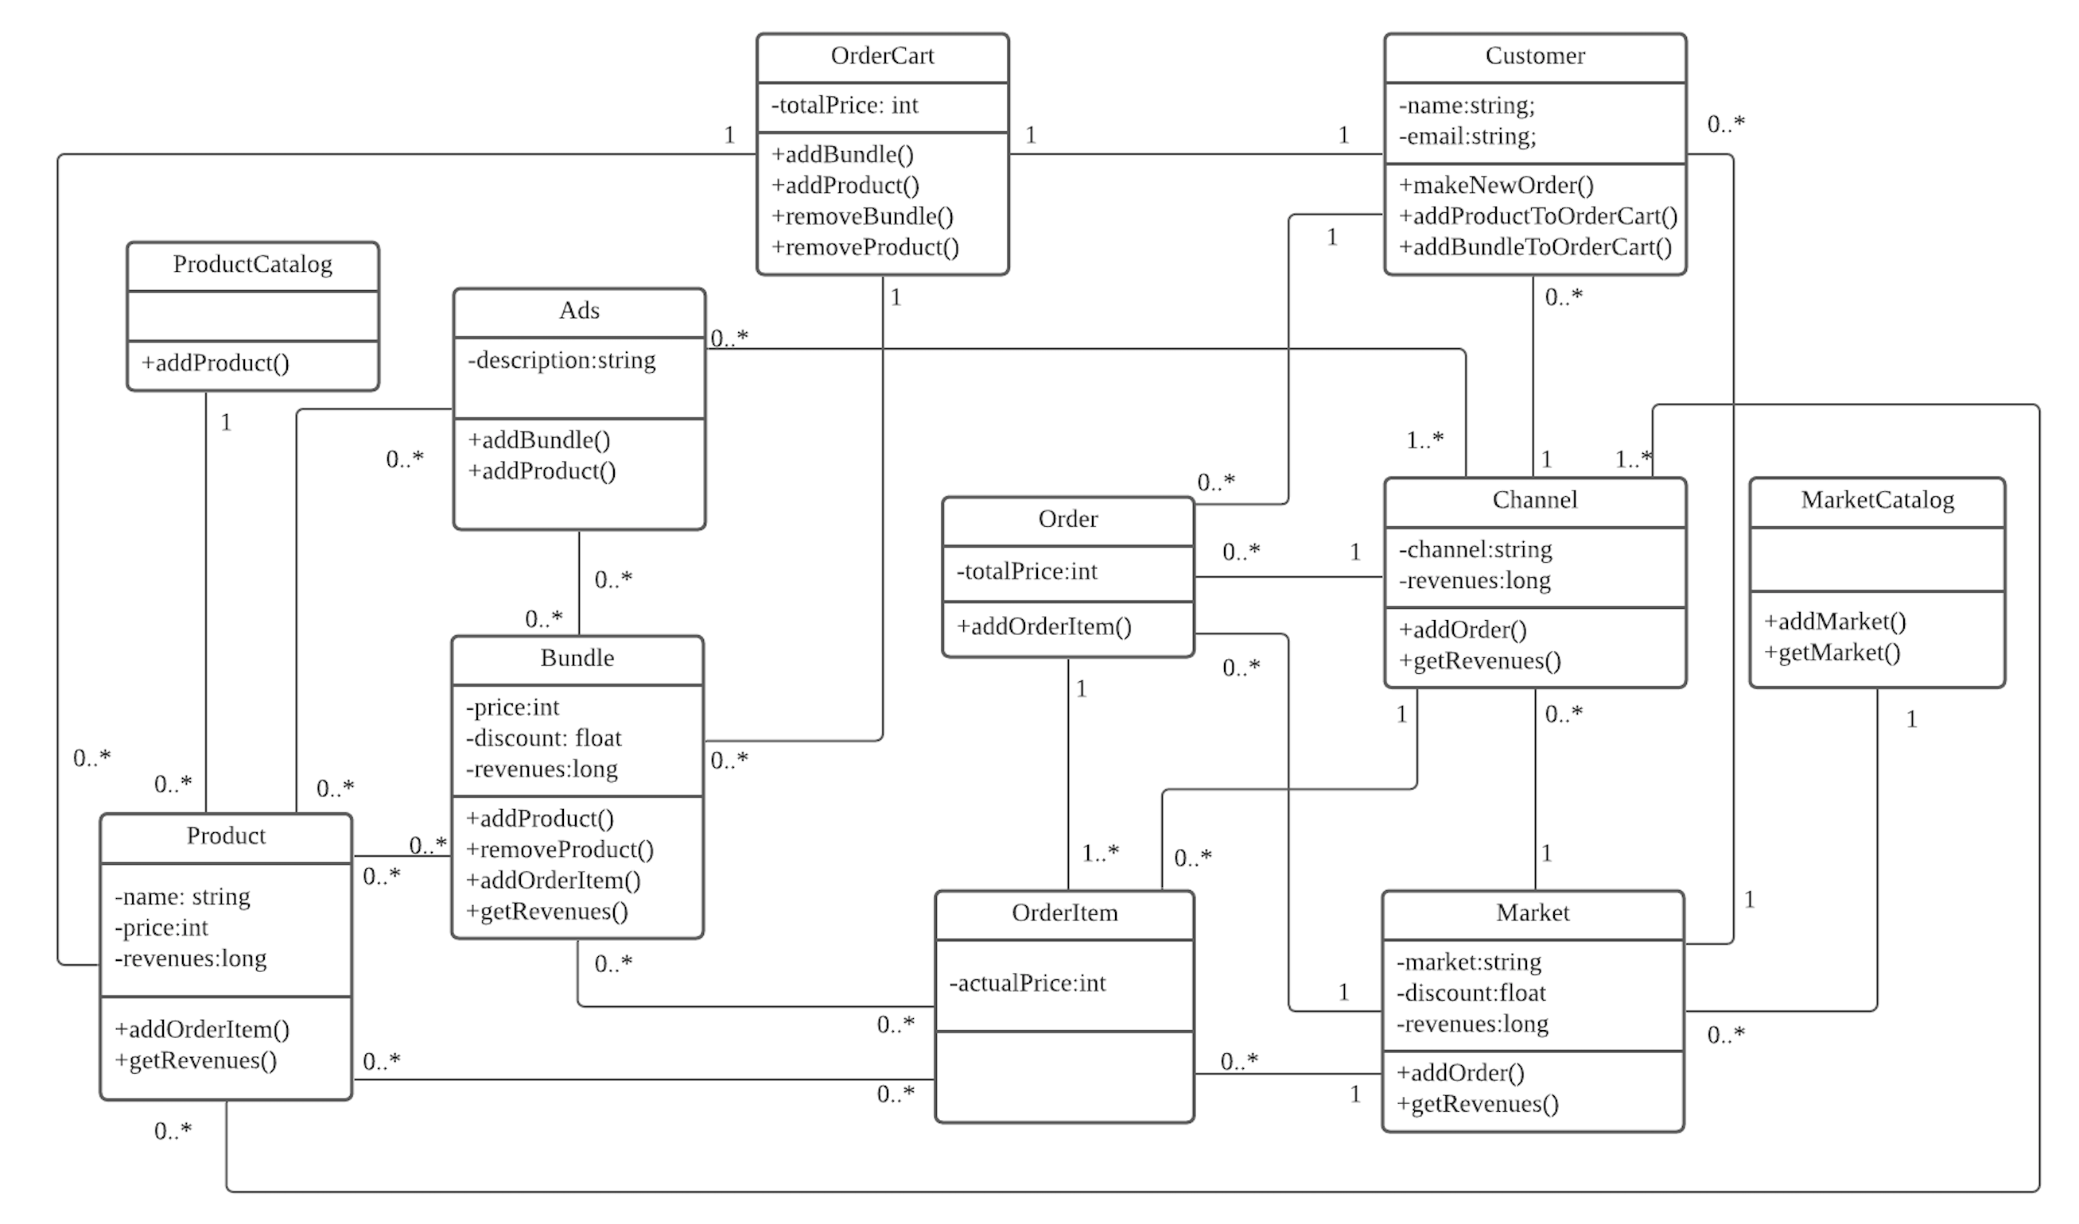
UML
选题背景意义

Slide 5

IMPROVEMENT
IMPROVEMENT1
IMPROVEMENT2
Manager Operation
Improve operation rights to managers:
Add Ads;
Add Bundles;
Add Products;
Database
Persist data

Slide 6
THANKS!

